Slide 1

StudyZone App
Ahmed Hassan, Mohamed Hemdan, Ahmed Essam

Slide 2

Feature 1: Study Planner
It helps you allocate study time for assignments and quizzes
It improves its time allocation based on average time taken for assignments and scores of quizzes
You can add unavailable times so that they are not allocated

Slide 3


Feature 2: Study Mode
It blocks notifications from certain apps
It can also block access to them for a specified amount of time
During a study period, you can’t uninstall the app
There are different types of blocks: continuous block and block with breaks for different study modes.

Slide 4

Feature 3: Study Pair Matching
If you like study with someone, the app will search for students to study with you based on certain specifications
The app sends you requests for other students who want to study with you and then you decide whether to approve or not

Slide 5

UI Design Android

Slide 6
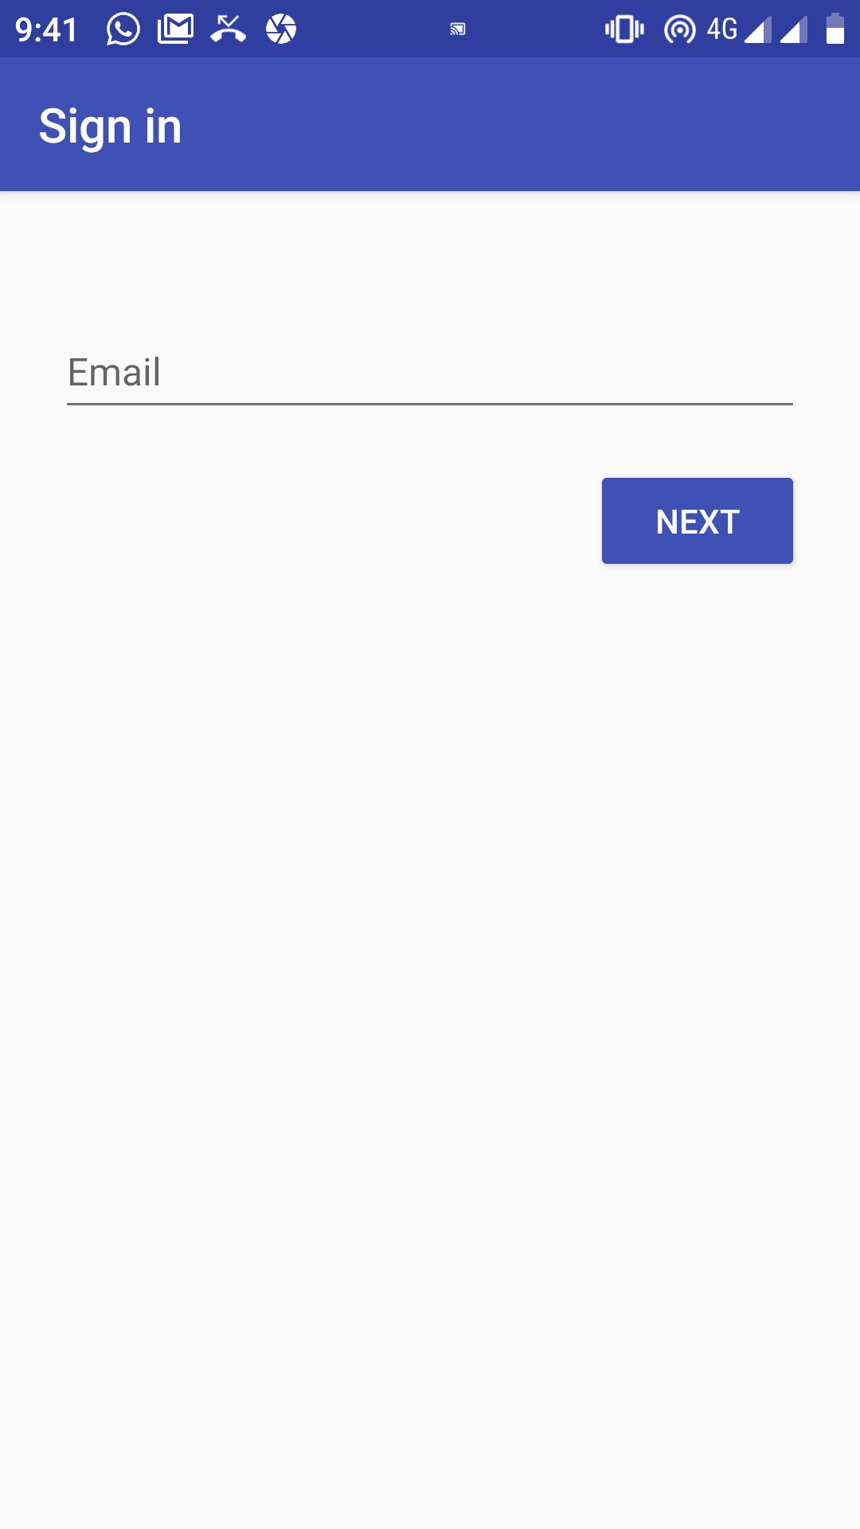
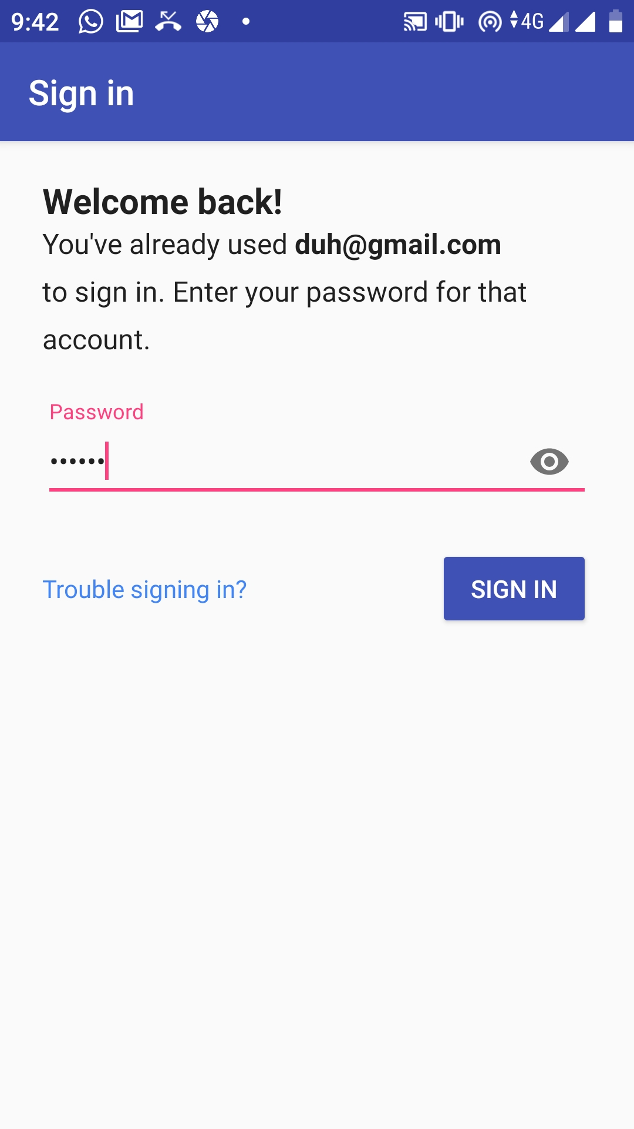

Login Overview
The login is done base on the email and password
Login is authenticated using Firebase.
Authentication tokens are sent to the back end to be stored in the database for future notifications or something

Slide 7
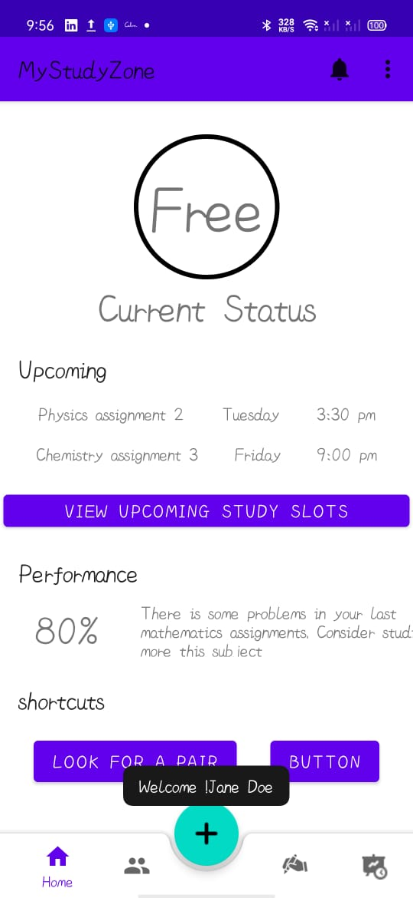
Home Page
The home page shows the current status of the student where he’s free, busy that he has something to do right now
There is also a list of the upcoming assignments and quizzes that are ordered descendingly by time and date. The user has the option to view the calendar from the “View Upcoming study slots”
There is also a performance metric that shows user performance based on the last days study hours and scores.
Also, there are some shortcuts to navigate through the app

Slide 8
Bottom Navigation Bar
Add new task Page
My Pairs Page
Study Mode Page
Home Page
Planner Page

Slide 9
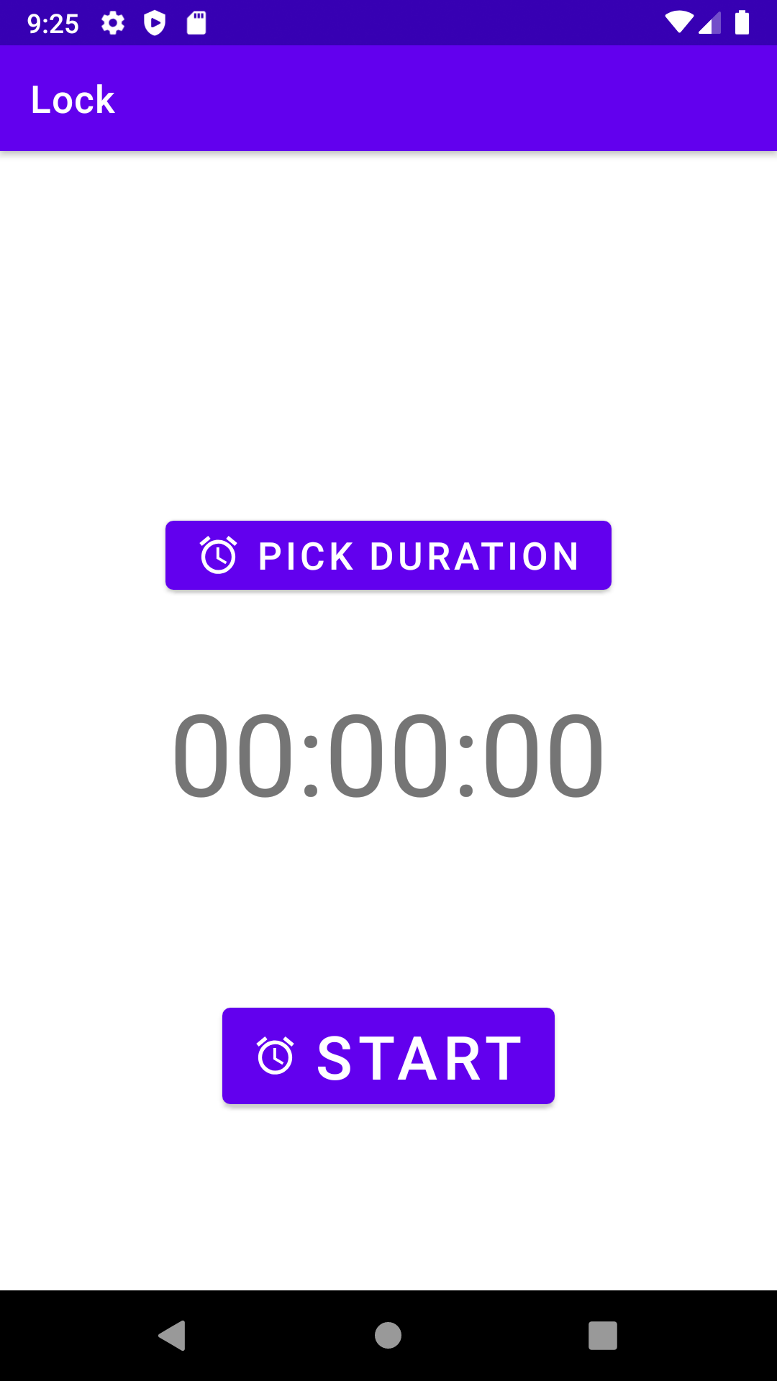
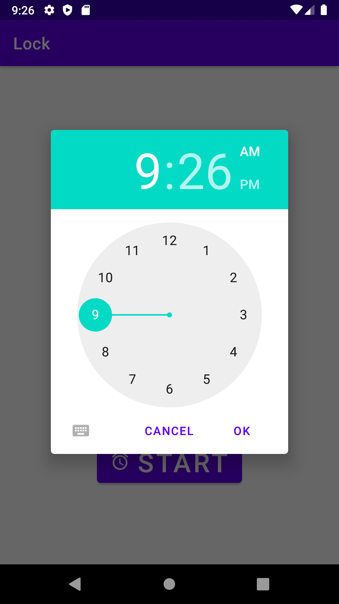
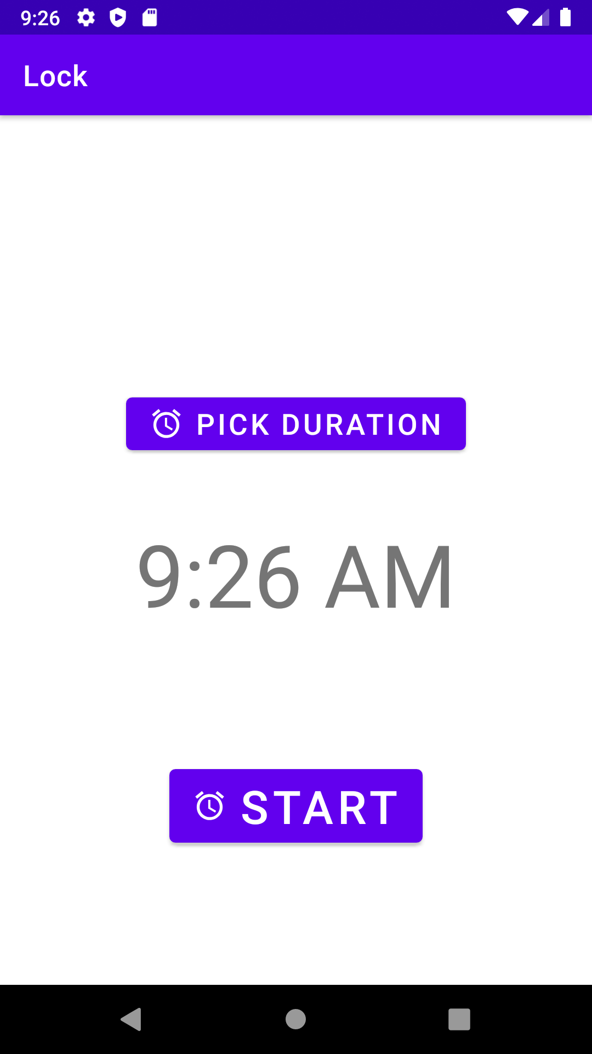
Study Mode

Slide 10
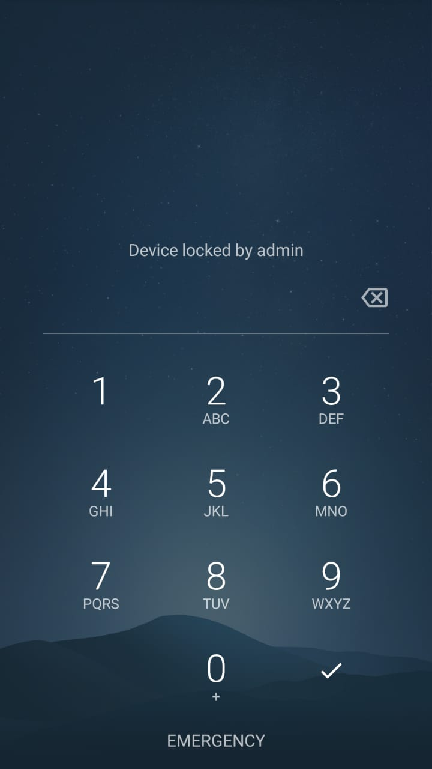
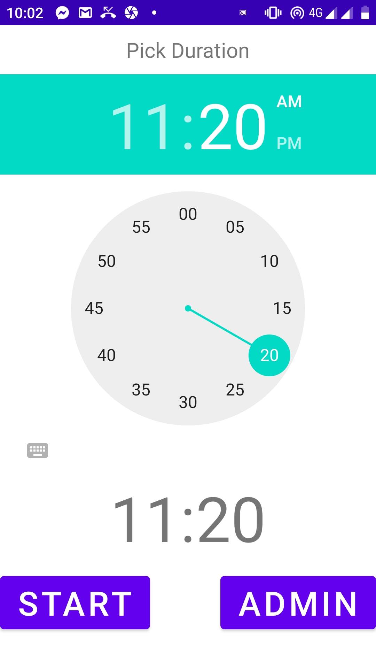
Study Mode
In the study mode, the app takes control over entire device for the specified duration
The device can’t be shut down
The feature is available in the current version
To enable this feature, the user should accept the permission request to control device lock screen

Slide 11
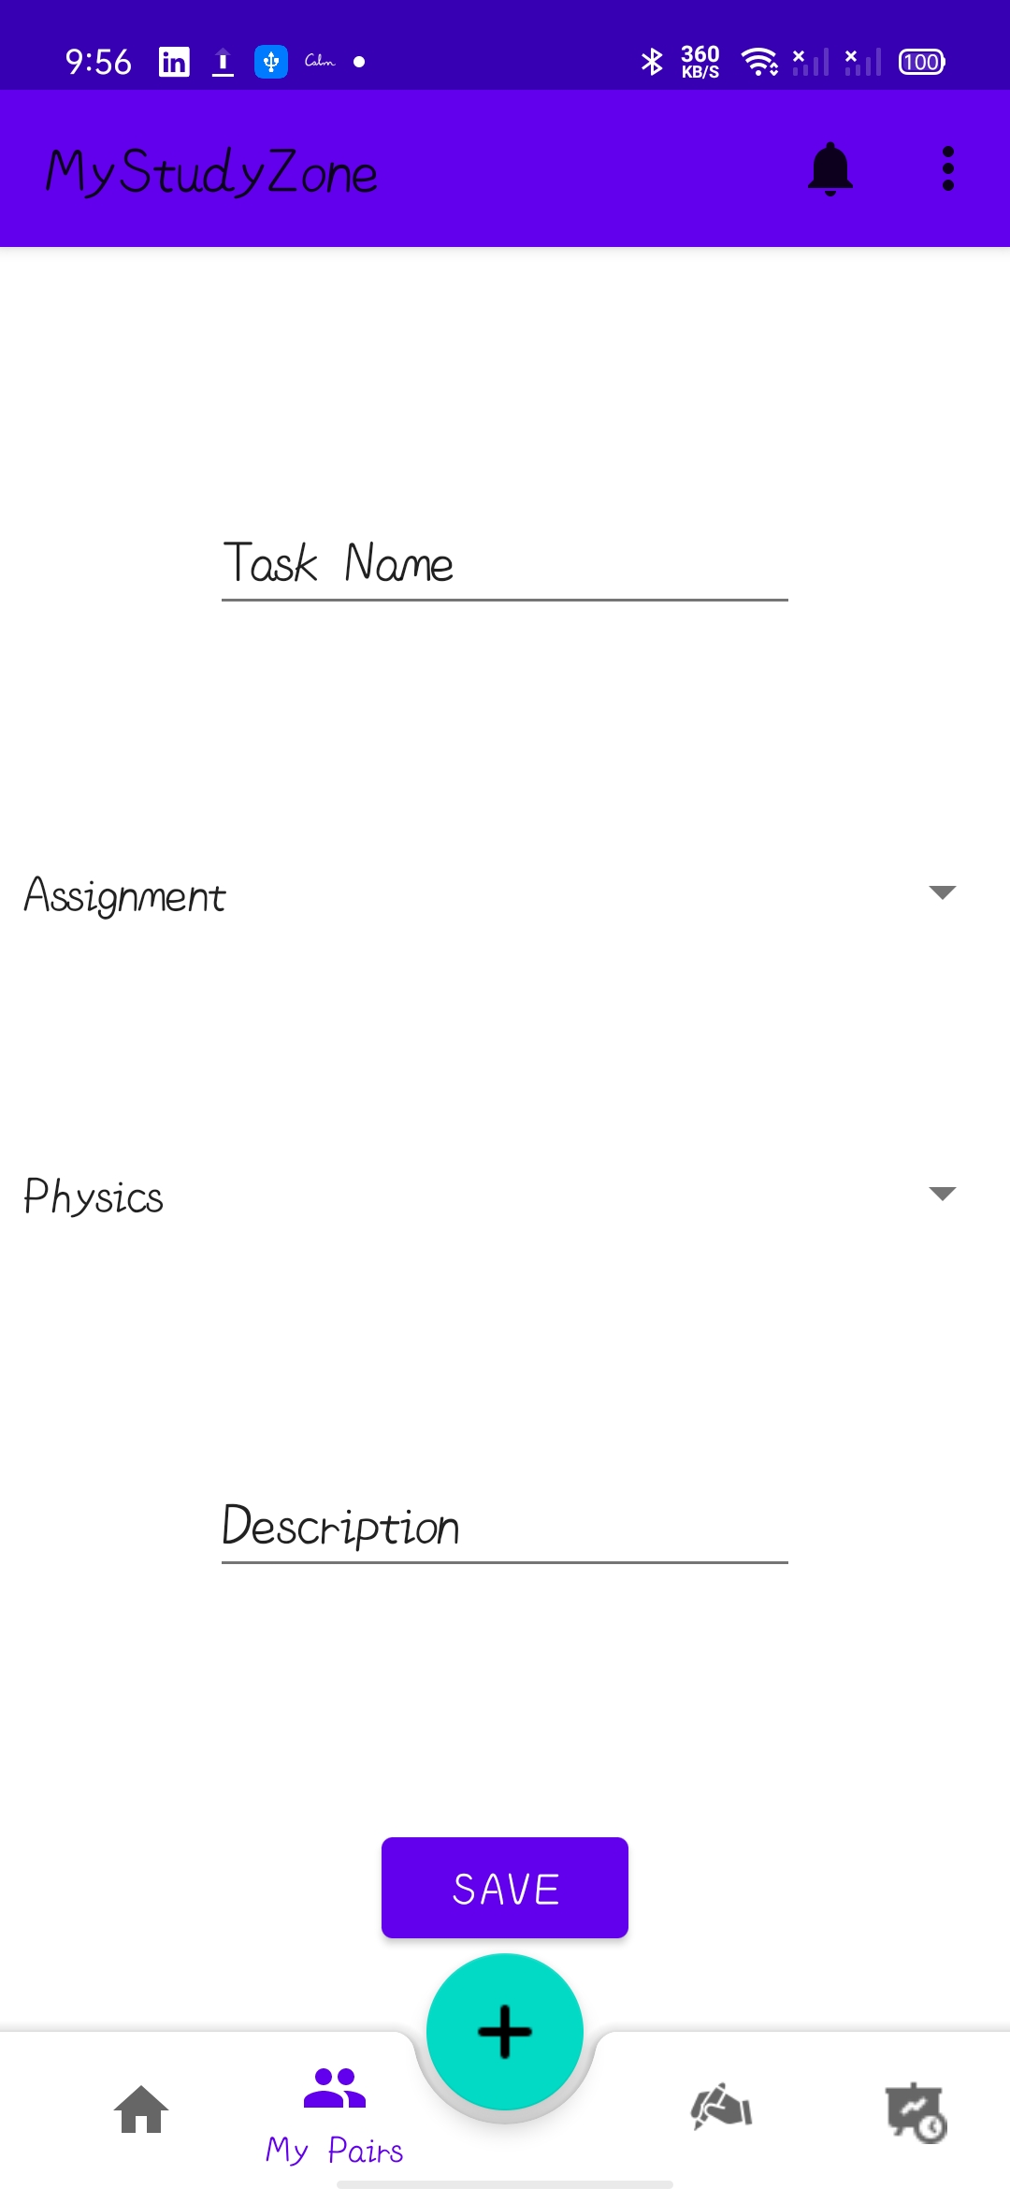
Add New Task
The user can add a new task by filling the shown blanks and clicks save
The information is automatically stored inside the Local Database and shown the front page if the task is so close

Slide 12
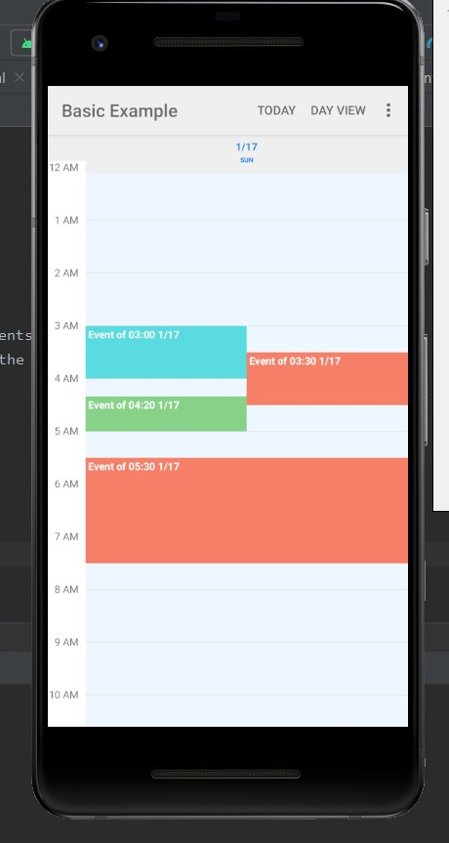
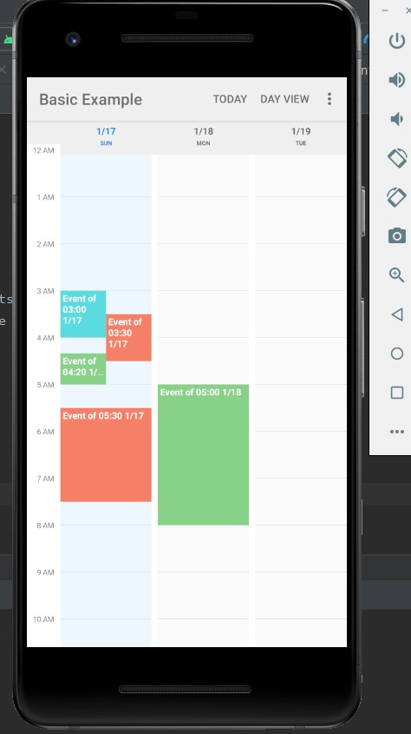
Study Planner
The study planner consists of three main pages:
The Synchronous calendar
The Asynchronous calendar
The monthly view
On each one, the data is retrieved from the Local database to be displayed
Each calendar can switch its view from day, 3 days to week view as shown in the figures

Slide 13
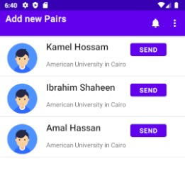
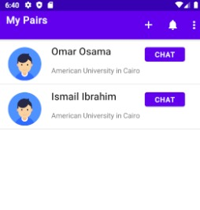
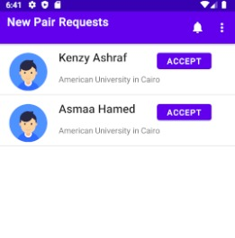
Pair Matching
There are three main pages for now which are shown here.
The user can send requests to some students to become pairs. Once accepted, the new pair is added to the My Pairs list.
The user also can chat with his pairs, but the chatting service is not yet enabled. Will be enabled in the next releases

Slide 14

Database

Slide 15

Local Database
A local database is implemented using Room database and SQLite
Three tables to store
Lecture (subject, date, start_time, duration)
For recording lecture times (so that no study allocation is done at that time)
Event (name, type, start_date, start_time, duration)
For any time, restrictions and other events
Deadline (name, category, subject, date, time, desc, grade)
For all tasks with deadlines (assignments, quizzes, projects, other tasks as well)
Grade is updated whenever possible by the user

Slide 16
Server-side Database
This database is used to store the tokens along with user ids, pairs for each student and requests as well
The tables are:
Accounts (name, id, university, grade)
Pairs (user_id, pair_id, pending)
Tokens (user_id, token)

Slide 17
Back-end Implementation

Slide 18

Back end and APIs
Some APIs were implemented in NodeJS to help the app retrieve some data from the database.
These are:
acceptRequest: to accept user invitation for pair matching
sendRequest: to send request to another user to become pair to some one
getMyPairs: to retrieve all pairs to that specific user
getRequests: to retrieve all requests to that specific user
getSuggestedPairs: to retrieve suggested pairs to the user
All these APIs are authenticated
If no-authorized user involves the server will not send any information about pairs, requests, and suggested ones

Slide 19

UI design iOS

Slide 20
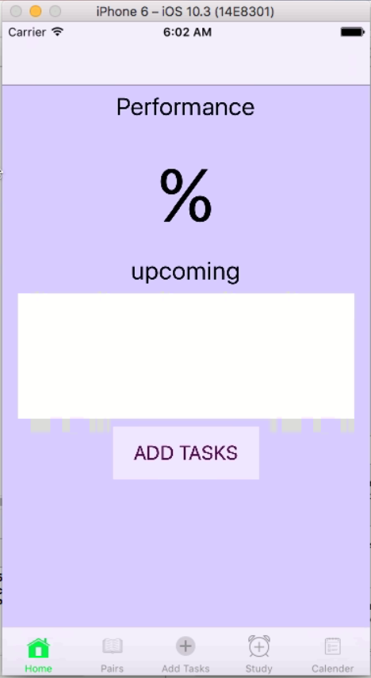
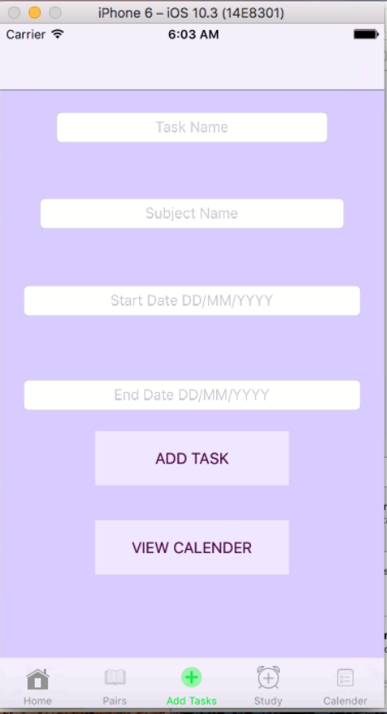
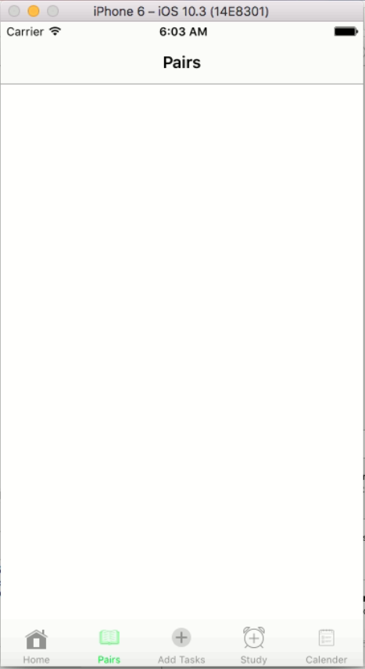
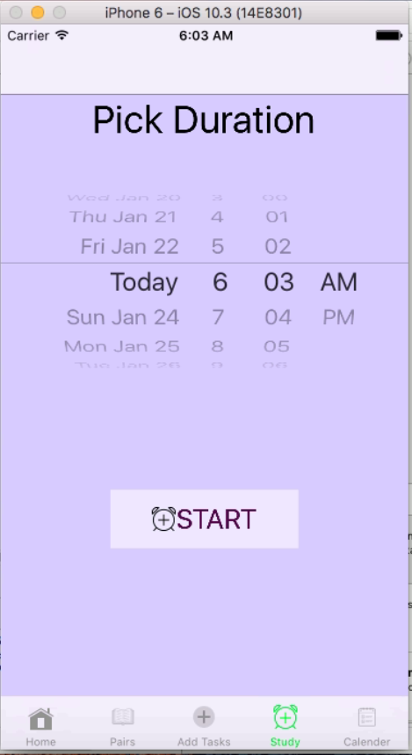
UI View Controllers

Slide 21
Next Release
Pair Chatting
Study Period Prediction
Data Linking with Blackboard and GMail

Slide 22

Thanks

